Slide 1
We Showed Up!
By:
Bana, Zamzam, Caren and Kimberley

Slide 2


What the video is about?
Our video is about the sports activities at Paddington rec. We talked to a few members of staff about people not using the cycling zone and areas that are free access.
We interviewed them and asked them questions about the free access for everybody.

Slide 3
Location:
Paddington Rec
Maida vale

Slide 4
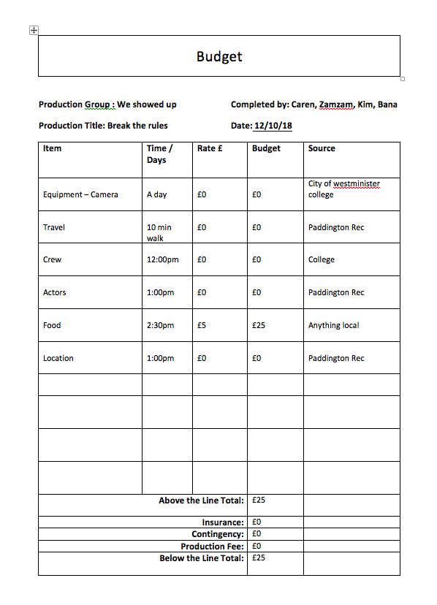
Budget:

Slide 5
The questions we will be asking
How long have you been coming here to ride your bike?
How do you feel about not being able to ride your bike in the park?
What does cycling mean to you personally?
How do you feel about your child not being able to play in this area?
What do you think the community could do to change this?

Slide 6
Equipment's:
Camera
Tripod
Adobe premiere Pro 2015 (Editing)

Slide 7
Planning:
Bana will be introducing what our film is about.
Shot of the signs
Interview 1
Another shot (Background music)
Interview 2
Shots of people cycling
Interview 3
Kids playing shot
Interview 4
Cycling on top of no cycling signs and kids playing next to no ball games sign shot.

